Slide 1
LABEL SOFT COPY PRINT SOP

Slide 2
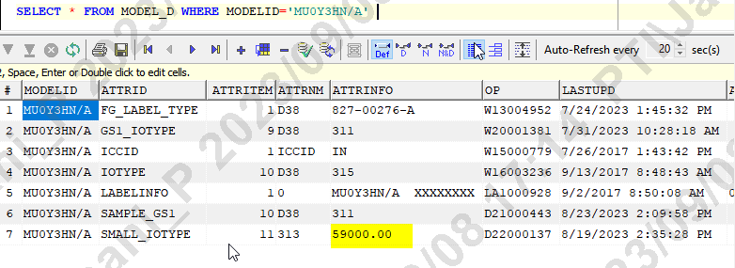
STEP 1 - TO PRINT SOFT COPY (PIKGP1QA)
DB : PIKGP1QA
TABLE MAINTAINENCE :
IOTYPE : 315 (Soft Copy) -- SELECT ATTRID FROM MODEL_D WHERE MODELID='MU0Y3HN/A' and attrid='IOTYPE'.
PRICE Need to be Maintained at-- SELECT ATTRINFO FROM MODEL_D WHERE MODELID='MU0Y3HN/A' and attrid='SMALL_IOTYPE'
Note : If Hard copy requested to print than make use of IOTYPE : 313 (Hard Copy) -- SELECT ATTRID FROM MODEL_D WHERE MODELID='MU103HN/A' and attrid='SMALL_IOTYPE'.

Slide 3
STEP 2 - TO MAINTAIN TEMPLATE AND PRICE IN PROD DB (PIKGP1)
DB : PIKGP1
TABLE MAINTAINENCE :
IOTYPE : 180 -- SELECT ATTRID FROM MODEL_D WHERE MODELID='MU0Y3HN/A' and attrid='IOTYPE'.
PRICE Need to be Maintained at-- SELECT ATTRINFO FROM MODEL_D WHERE MODELID='MU0Y3HN/A' and attrid='SMALL_IOTYPE'

Slide 4


